Slide 1


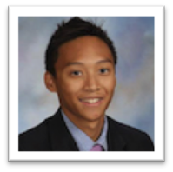
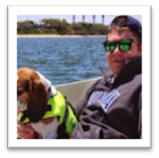
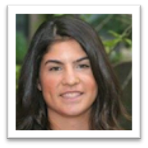
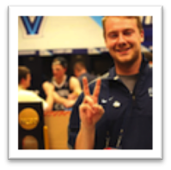
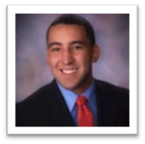
“Hands - free
texting”
DYLAN
LE
TOM
KENNEDY
SHANNON
RHODES
ZAC
RAHN
MATTHEW
GUZMAN

Slide 2



PROBLEM
Identifying real-world issues
Forgetting to text a loved one -- letting them know you have arrived at a destination
Afraid of texting and driving to let someone know you’re almost there.
Can’t text while driving
Going to unsafe locations
OPPORTUNITY
MOBILE APP
TO TACKLE THESE ISSUES
Unable to contact person, but have their location and ETA
Notes:
Tom

Slide 3

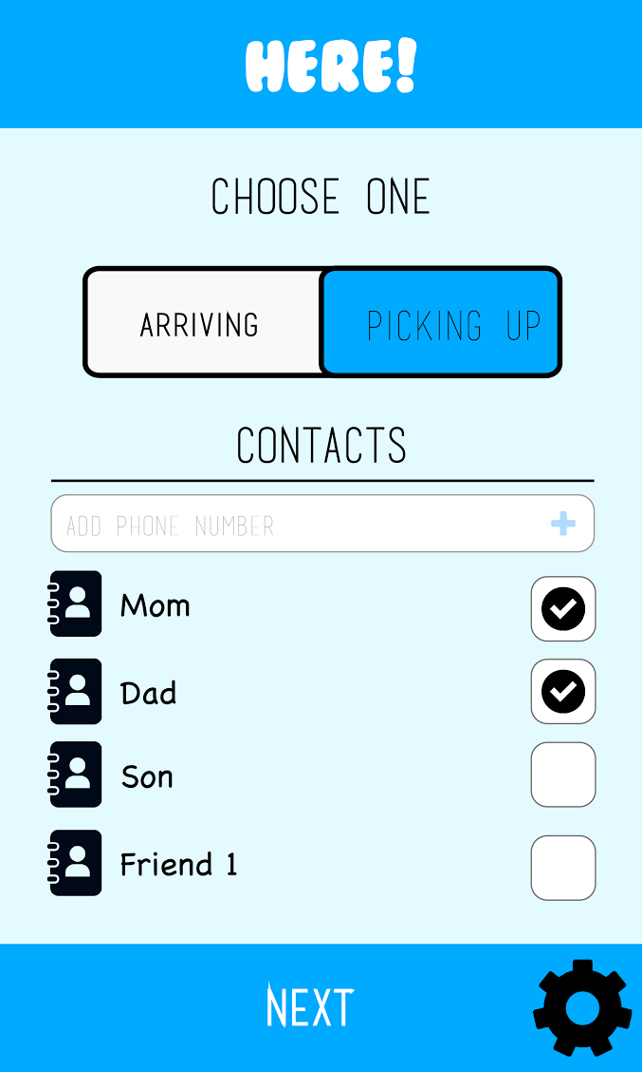
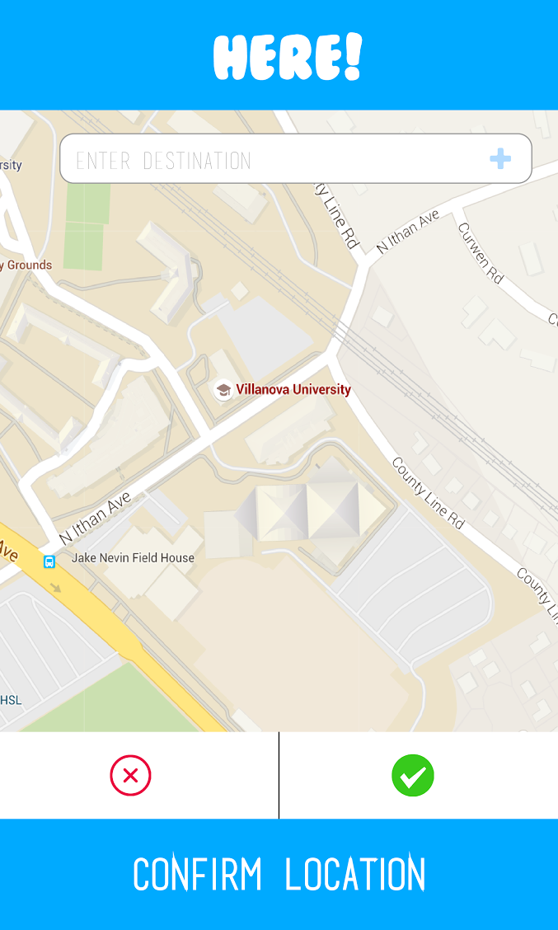
OUR SOLUTION
The mobile app that automatically texts when you arrive!
FUNCTIONALITY
TWO OPTIONS:
(ARRIVE OR PICKUP)
TEXTS AUTOMATICALLY BASED ON GPS RANGE to send ETA’s
SENDS TO CONTACTS IN YOUR PHONE
CUSTOMIZABLE MESSAGES
MINIMIZED COMPLEXITY
ABILITY TO TRACK FRIENDS/PEERS/FAMILY
GOOGLE MAPS IMPLEMENTATION
Mission Statement
Here! to help offer a peace of mind for you, your family, and friends while traveling from point A to B.
Notes:
Tom

Slide 4
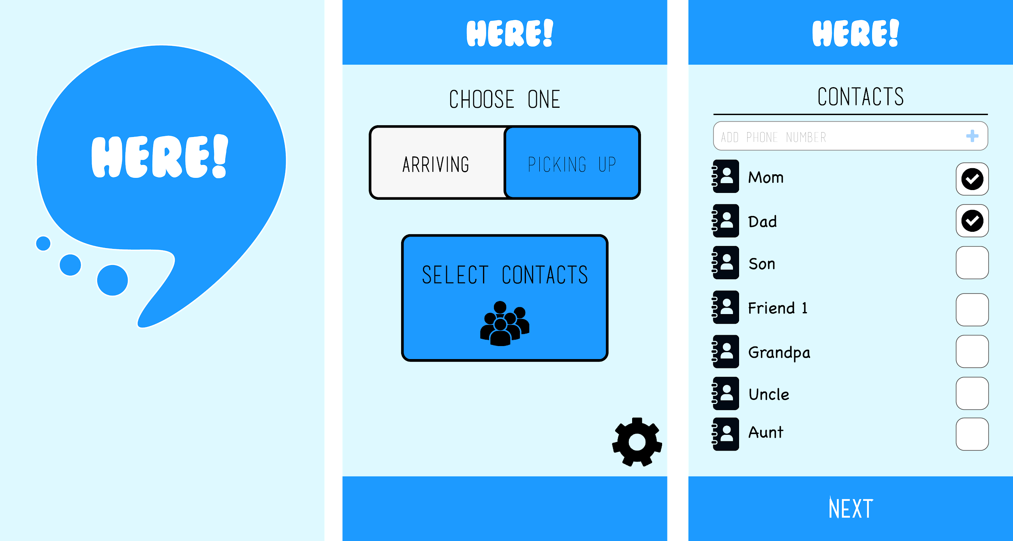

Slide 5
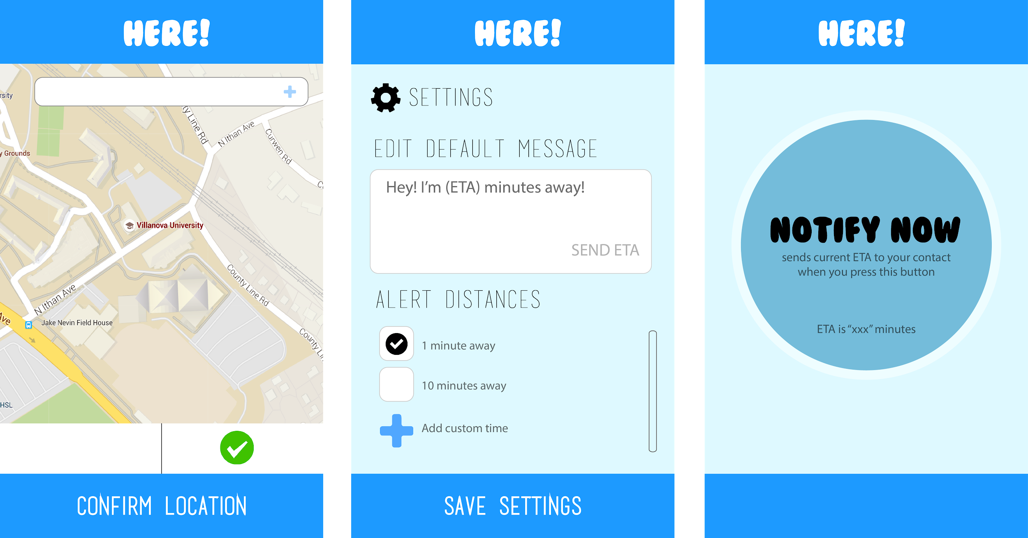

Slide 6
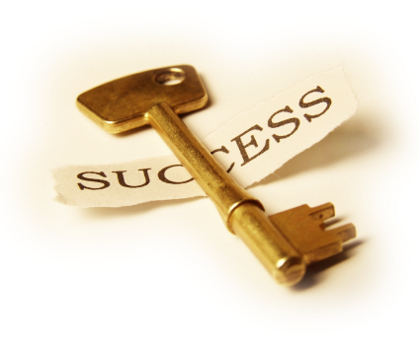

KEY BENEFITS
OF
Simplicity
Hands-free texting
Simple Interface.
App uses texts: does not require both parties to own the app.
Free
Saved/Favorite Trips
GPS Map
Send automatic ETA’s
Notes:
Dylan

Slide 7

COMPETITIVE ADVANTAGE
SO EASY TO USE, NO TUTORIAL NEEDED
RETENTION
RELIABLE
NOT LIMITED TO CERTAIN
AGE / GROUP
SIMPLE CONCEPT
LITTLE COMPETITORS
Notes:
Dylan

Slide 8
MARKETING & SALES
MARKET
1.4 BILLION ANDROID USERS
WORLDWIDE
ADVERTISEMENTS
*PRO VERSION
SELL OUR APP
Banner ADs
Short Videos
Sponsored Pop-Ups
Make Viral Video w/ App
Celebrity Endorsement
Allows customizable messages
Favorites
Save previous trips
No Advertisements
Ability to notify multiple contacts
Sell our app to companies who have similar concepts
UBER
GPS Apps
Social Media?
Notes:
Matt Guzman

Slide 9
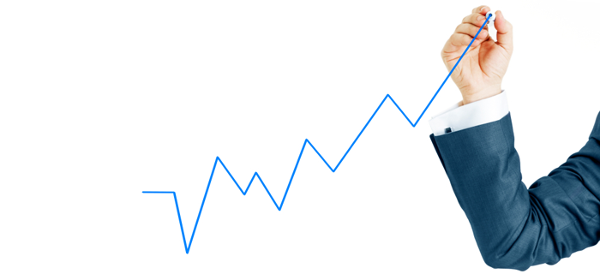
FINANCIAL MODEL
Questions to consider:
How do you plan to make money?
How will you differentiate your product or service from what is already out there?
How do you know people will purchase your product? And at what price point?
MARKETING STRATEGY
Advertising
Promotions
Campaigning
Team up with UBER
*Use App = free ride
Mobile advertising
- Amtrak
- JetBlue
-Southwest
-Travel companies
STOP
TEXTING & DRIVING
AT&T, Public Safety
Commercial Advertising
Prevent driving accidents
TARGET MARKET:
Although our demographic applies to anyone with a smartphone, we anticipate the primary users of this application to be mothers and their children. 88% of American mothers with mobile phones have smartphones; they rely on their smart phones to stay in contact with their children.
Notes:
Matt Guzman

Slide 10
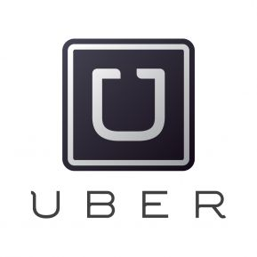
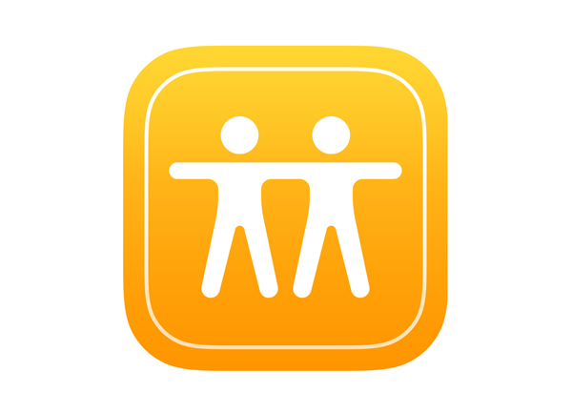
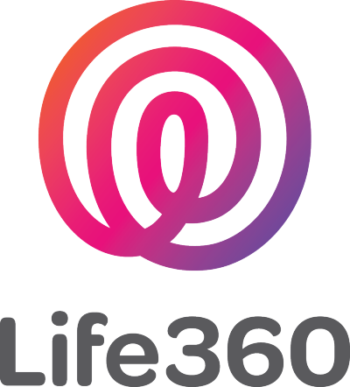
COMPETITION
FIND MY FRIENDS
SIMILAR FUNCTIONALITY, DIFFERENT GOALS
Notes:
Shannon

Slide 11
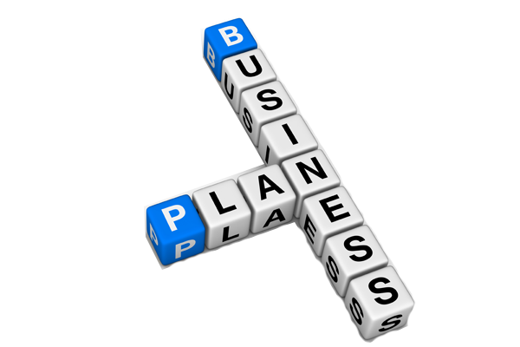
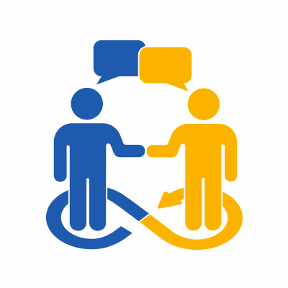

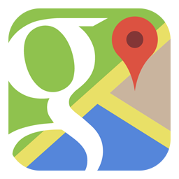
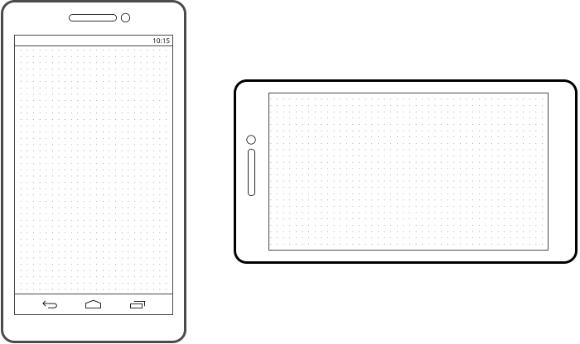

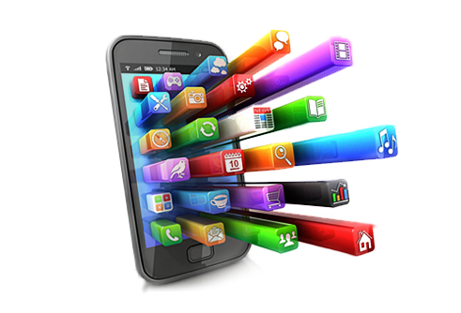

STATUS AND TIMELINE
Feedback: Address issues, and evaluate customer concerns. Back to drawing board. Implement and design features.
Creating business plan, with our marketing strategy, and target market.
Implementation of Google Maps into our App.
Rough storyboard of app’s functionality with ideas of use cases.
Application: Able to send SMS messages out to selected contacts.
Add customization of message and selection of contacts
Initial Launch: App is ready to be marketed to general public
Creating graphical designs of our app, logos, etc. Hear feedback from students about our app idea.
Assign team roles and begin development.
Prototyping: Testing out potential users. Trial for friends, peers, and family.
Notes:
Shannon

Slide 12
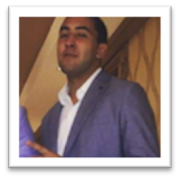
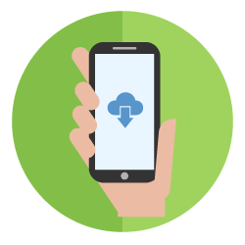
TEAM
GRAPHIC DESIGN
PROGRAMMER
PROGRAMMER
PROGRAMMER
BUSINESS MODEL
Notes:
Zac

Slide 13
DYLAN
LE
TOM
KENNEDY
SHANNON
RHODES
ZAC
RAHN
MATTHEW
GUZMAN
THE MOBILE APP THAT
AUTOMATICALLY TEXTS
WHEN YOU ARRIVE!
CONCLUSION
Notes:
Zac

